Slide 1


Shield Insurance
Pilot Project Analysis
By
Md Shafi Alam (AtliQ Technologies)

Slide 2
Problem Statement
Enhance decision making with actionable insights
Visibility in revenue and customer growth across sales mode
Insights on policy preferences in different age groups

Slide 3
Problem Statement
Enhance decision making with actionable insights
Visibility in revenue and customer growth across sales mode
Insights on policy preferences in different age groups

Slide 4
Problem Statement
Enhance decision making with actionable insights
Visibility in revenue and customer growth across sales mode
Insights on policy preferences in different age groups

Slide 5
Problem Statement
Enhance decision making with actionable insights
Visibility in revenue and customer growth across sales mode
Insights on policy preferences in different age groups

Slide 6
Agenda
Customer Analysis
Revenue Analysis
Sales Mode Analysis
Age Group Analysis

Slide 7
Agenda
Customer Analysis
Revenue Analysis
Sales Mode Analysis
Age Group Analysis

Slide 8
Agenda
Customer Analysis
Revenue Analysis
Sales Mode Analysis
Age Group Analysis

Slide 9
Agenda
Customer Analysis
Revenue Analysis
Sales Mode Analysis
Age Group Analysis

Slide 10
Agenda
Customer Analysis
Revenue Analysis
Sales Mode Analysis
Age Group Analysis

Slide 11
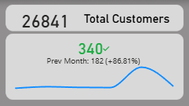
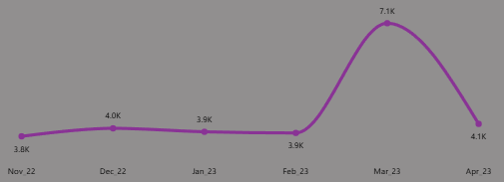
Customer Analysis
82% or 2200 customers surge against previous month in March, 23

Slide 12
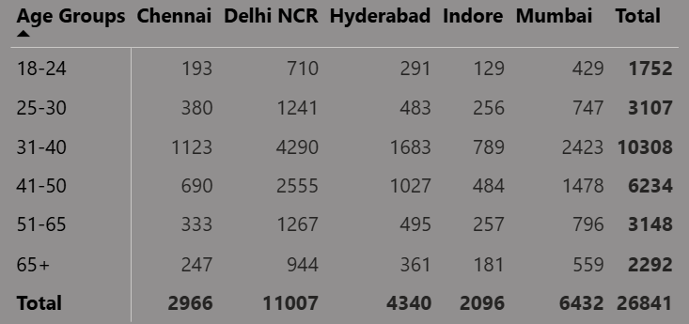
Customer Analysis
Delhi NCR, Mumbai are the growth engine
Indore and Chennai remains fairly untapped

Slide 13
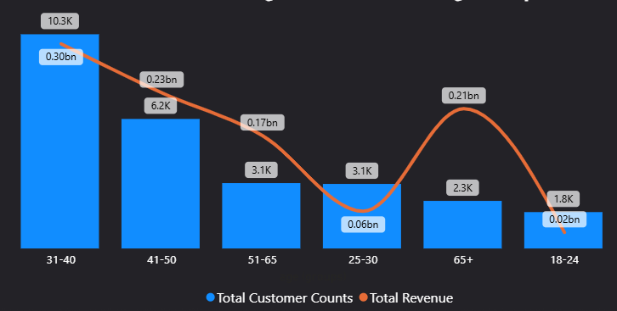
Customer Analysis
(31-40) is the core segment
(41-50) has also high customer & revenue
(65+), (51-65) has lesser customer but higher revenue
(18-24), (25-30) has lower customer and revenue

Slide 14
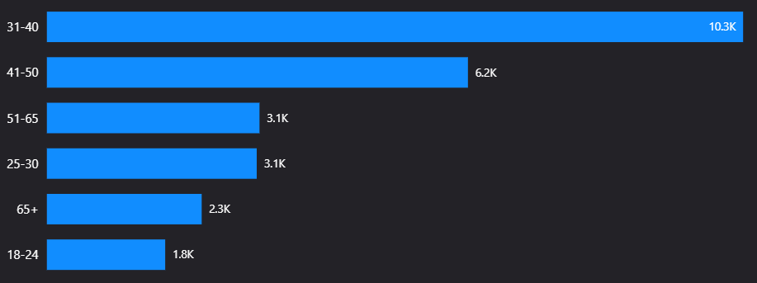
Revenue Analysis
Age Group Analysis

Slide 15
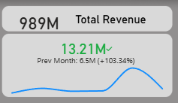
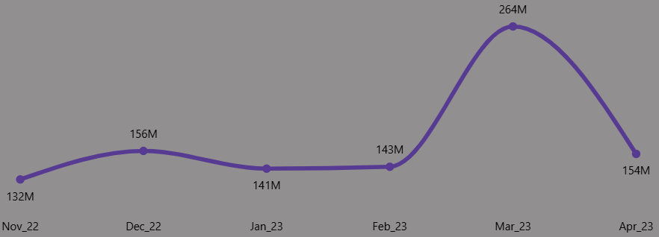
Revenue Analysis
Similar 84% or 121M Rupees revenue surge against previous month in March, 23

Slide 16
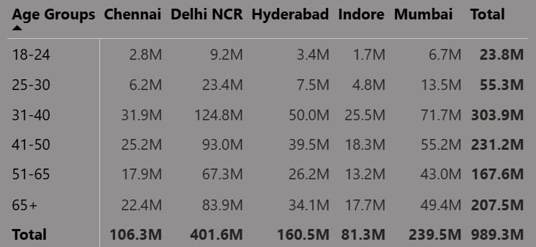
Revenue Analysis
Delhi NCR, Mumbai are the leader in revenue
While Indore and Chennai has lower revenue

Slide 17
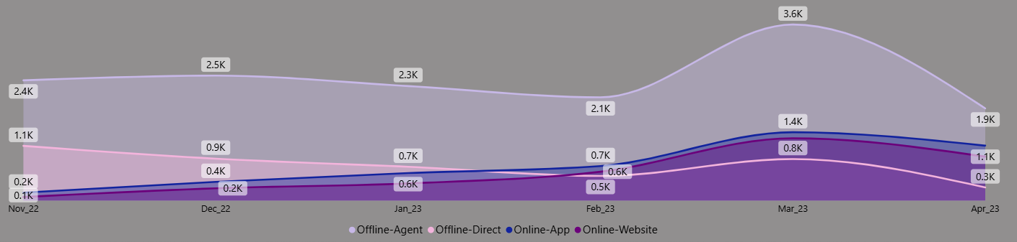
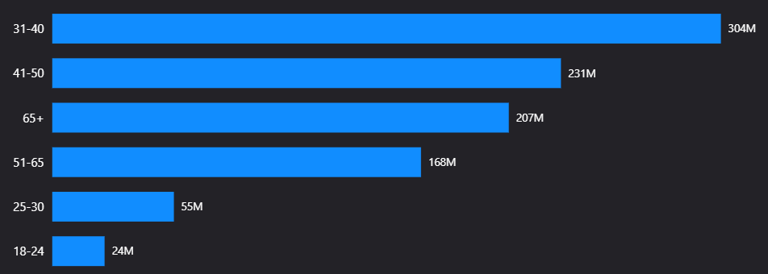
Sales Mode Analysis

Slide 18
Sales Mode Analysis
Offline – Agent is way higher than other modes
Online – App & Website is the rising sales modes
Offline – Direct is loosing popularity

Slide 19
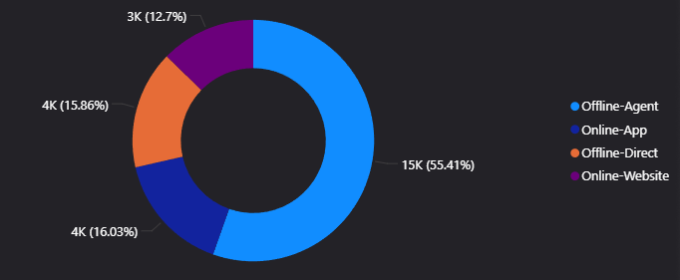
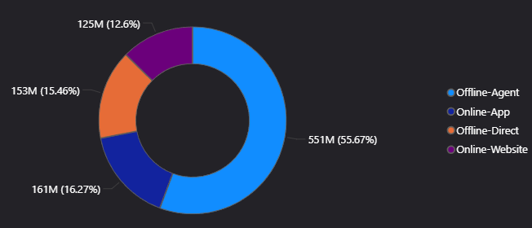
Sales Mode Analysis
Offline – Agent dominates both (55%)
Online – App & Website underperforming relative to market potential

Slide 20
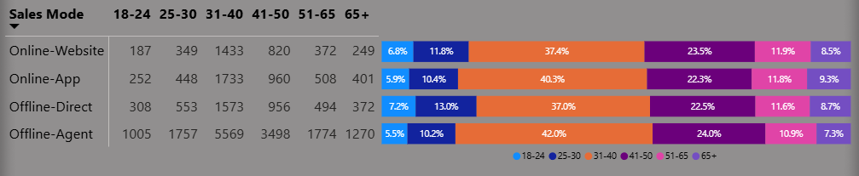
Age Group Analysis
(31-40) buys mostly from App and Agent
(18-24) buys mostly from Direct offline

Slide 21
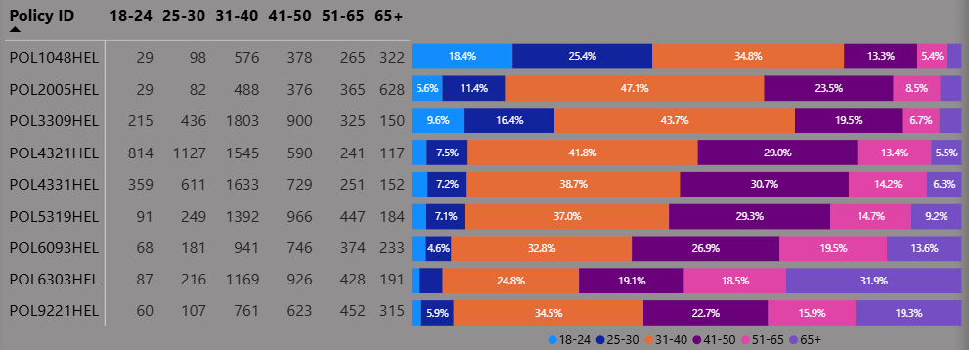
Age Group Analysis
POL1048HEL is the most popular among youngsters
POL2005HEL is the most popular among mid-aged
POL6303HEL is the most popular among elders

Slide 22
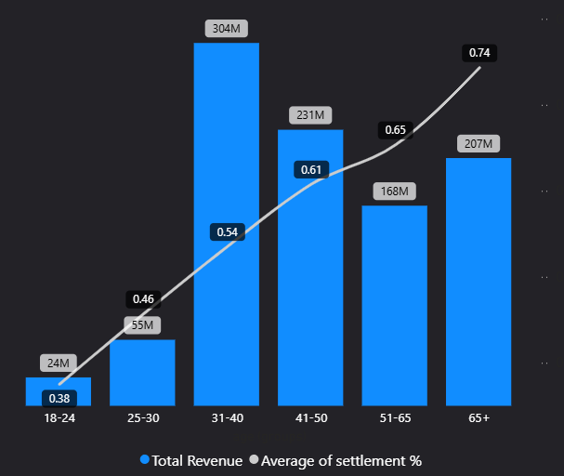
Age Group Analysis
(65+) has the best settlement rate, shows payment reliability
(31-40), (41-50) has the best balance between settlement & revenue

Slide 23
Suggestions

Slide 24
Suggestions
Grow younger customer segment
1. Launch affordable policies
2. College & University campaigns

Slide 25
Suggestions
Grow younger customer segment
1. Launch affordable policies
2. College & University campaigns

Slide 26
Suggestions
Grow younger customer segment
1. Launch affordable policies
2. College & University campaigns

Slide 27
Suggestions
Capitalize on Senior customers
1. Due to highest earning potential per customer, tailor senior specific plans

Slide 28
Suggestions
Capitalize on Senior customers
1. Due to highest earning potential per customer, tailor senior specific plans

Slide 29
Suggestions
Expand to smaller markets of Indore & Chennai
Replicate March Surge reasons intentionally
Boost Online sales mode through app & website

Slide 30
Suggestions
Expand to smaller markets of Indore & Chennai
Replicate March Surge reasons intentionally
Boost Online sales mode through app & website

Slide 31
Suggestions
Expand to smaller markets of Indore & Chennai
Replicate March Surge reasons intentionally
Boost Online sales mode through app & website

Slide 32
Thank You

